Slide 1


Project 3 no wait 2 or maybe it's 3
Ash, Patty, Rosa, Tu Cam, Vik

Slide 2
Agenda
Using Akashfu this assignment was put together
Setting up MongoDB database
Connecting to Flask
Establishing website dashboard
Updated the database
Set up various visualizations
Not presenting the dashboard instead presenting a powerpoint
Had fun and ranted on

Slide 3
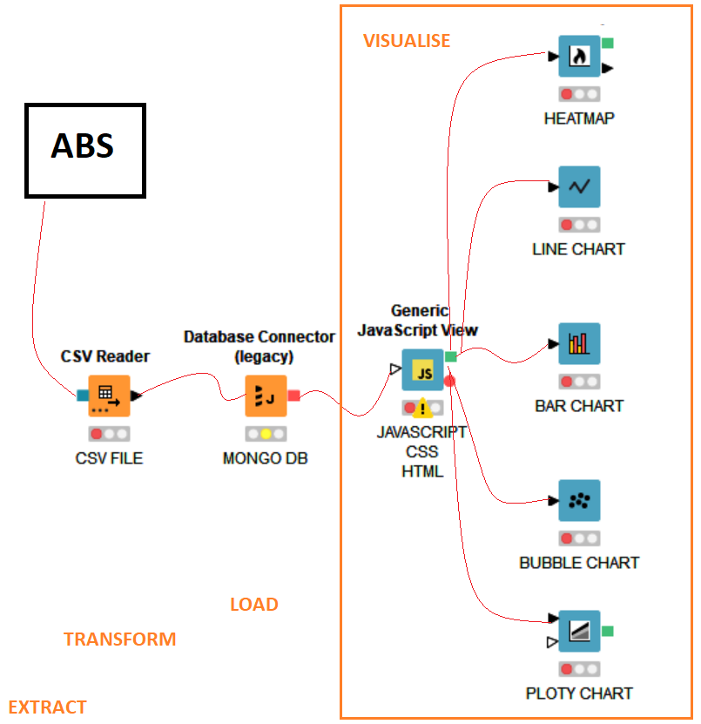

Architecture

Slide 4
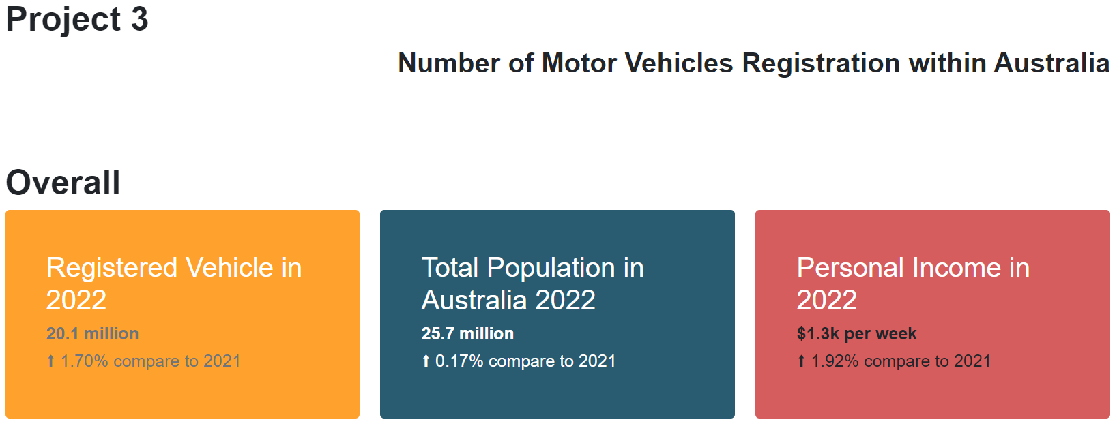
Dashboard – Overall

Slide 5
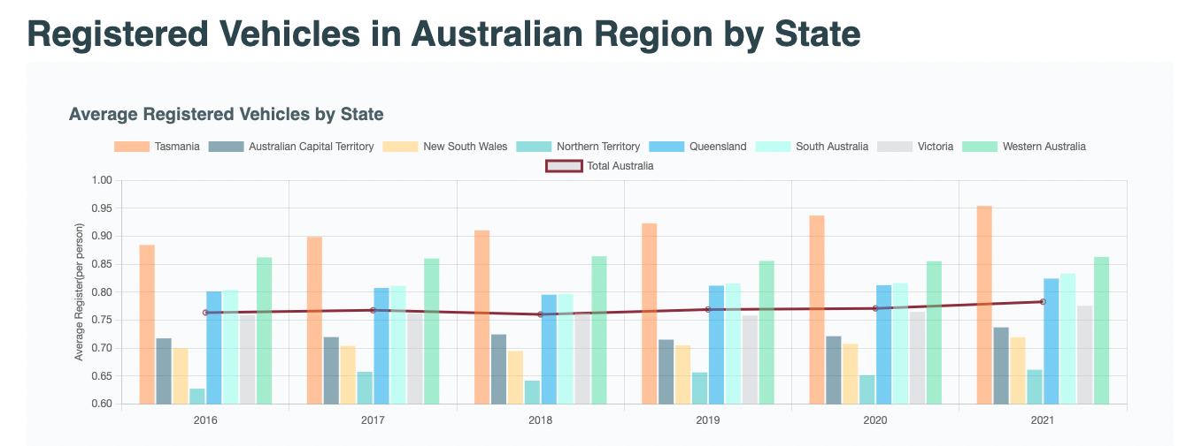
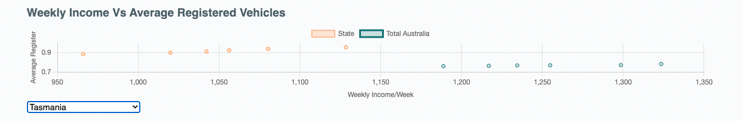
Dashboard – bar chart
http://192.168.0.168:9090/

Slide 6
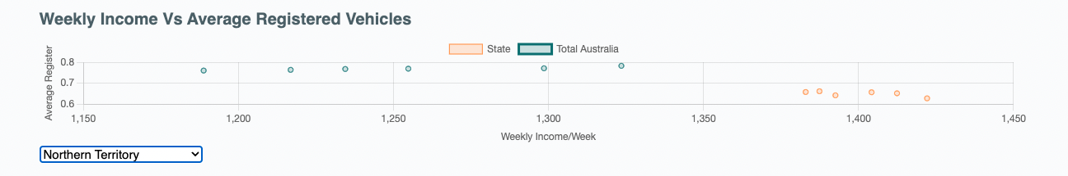
Dashboard – bar chart
http://192.168.0.168:9090/

Slide 7
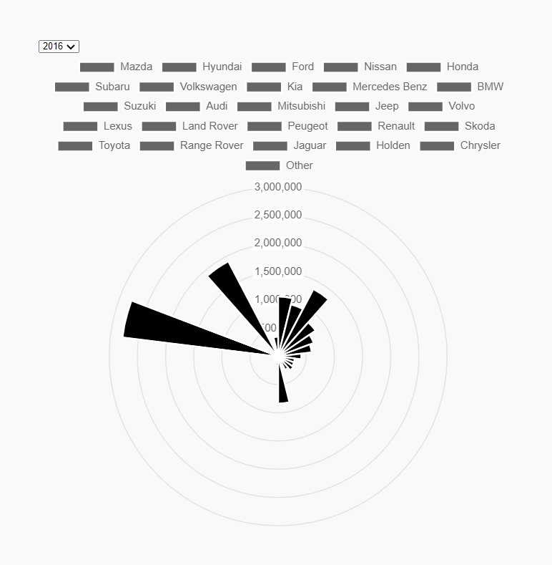
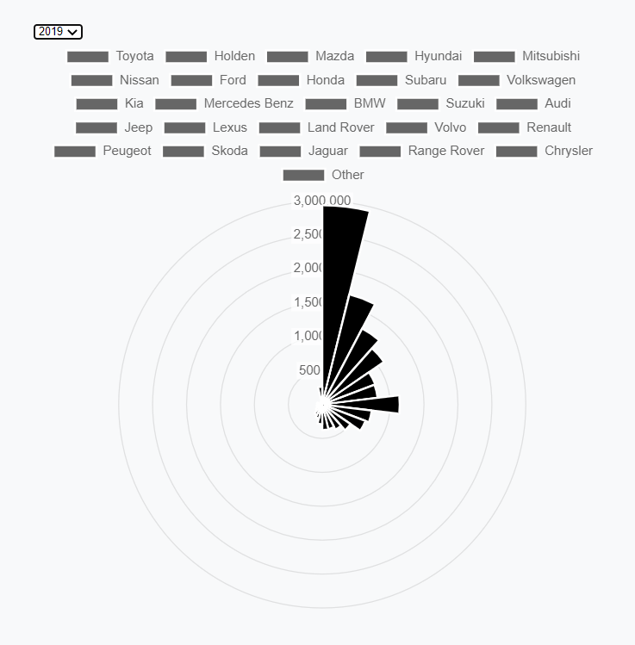
Dashboard – Polar chart
Setup separate API JSON from Flask Connection to Mongo db
Using Javascript setup the interactive polar chart to visually display the relationship between car brands and number of registrations
Using the toggle you can see this relationship evolve over time
Top 3 brands over 5 years include: Toyota, Mazda, Holden

Slide 8
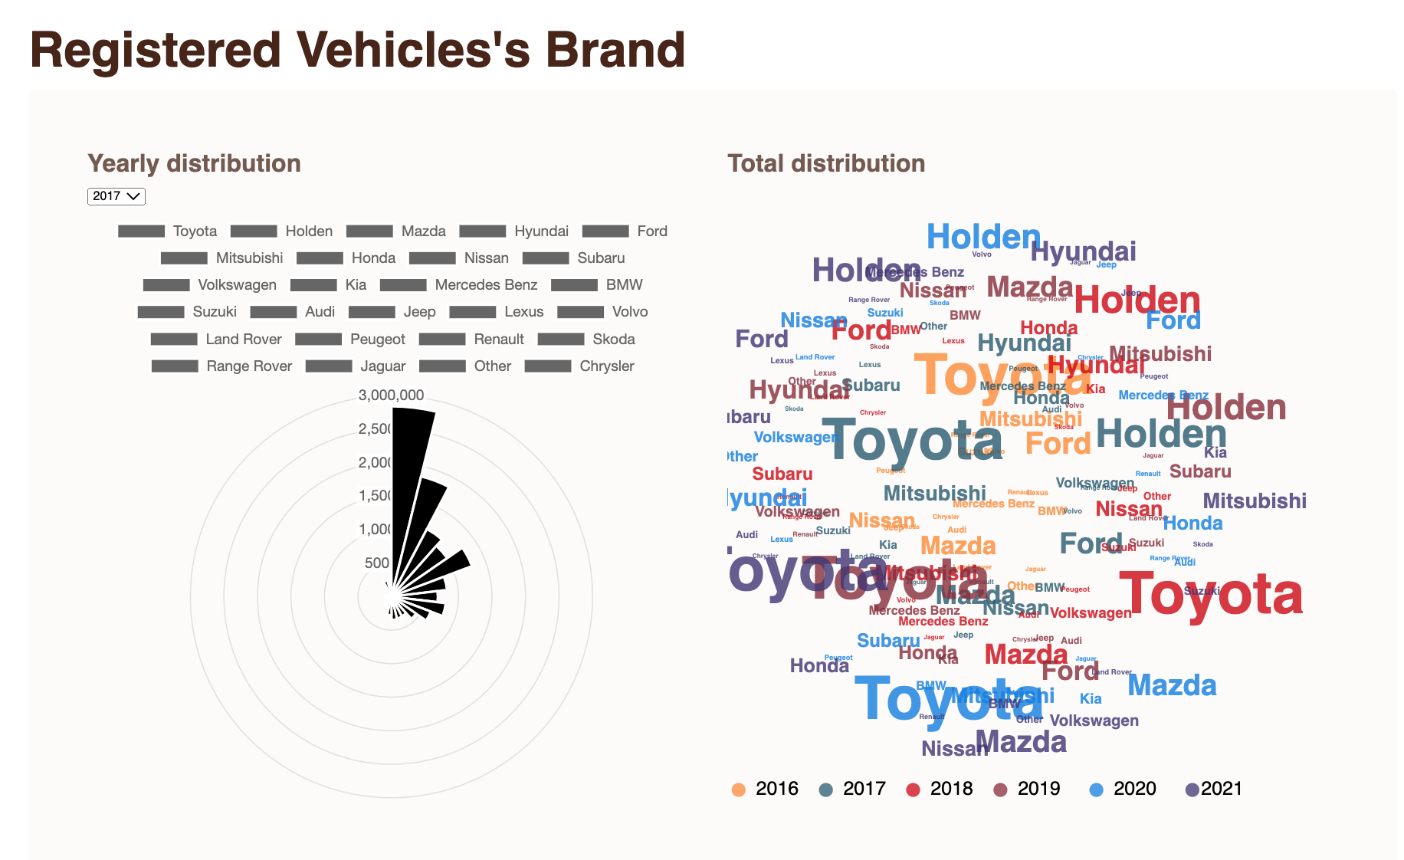
Dashboard – Polar chart

Slide 9
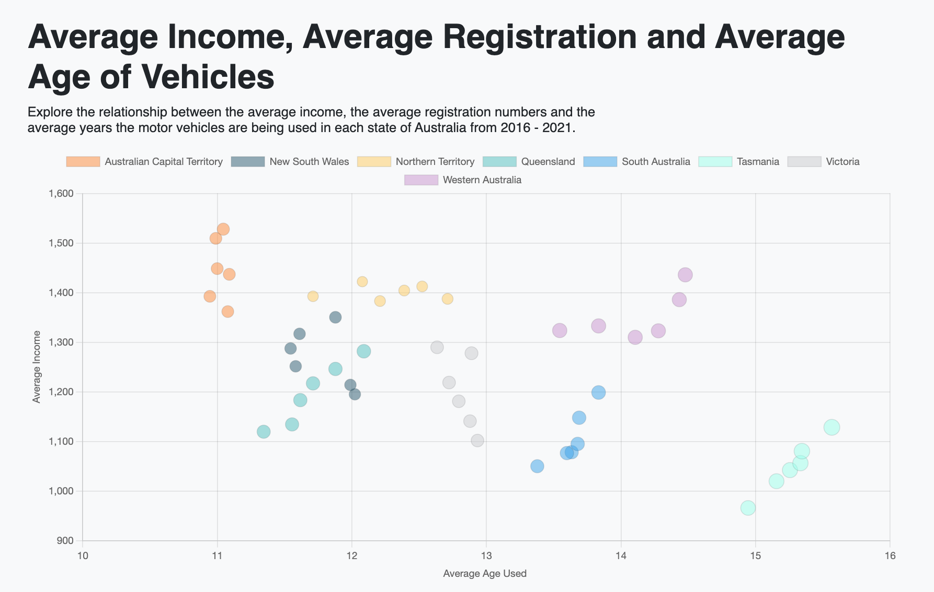
Dashboard – bubble chart

Slide 10
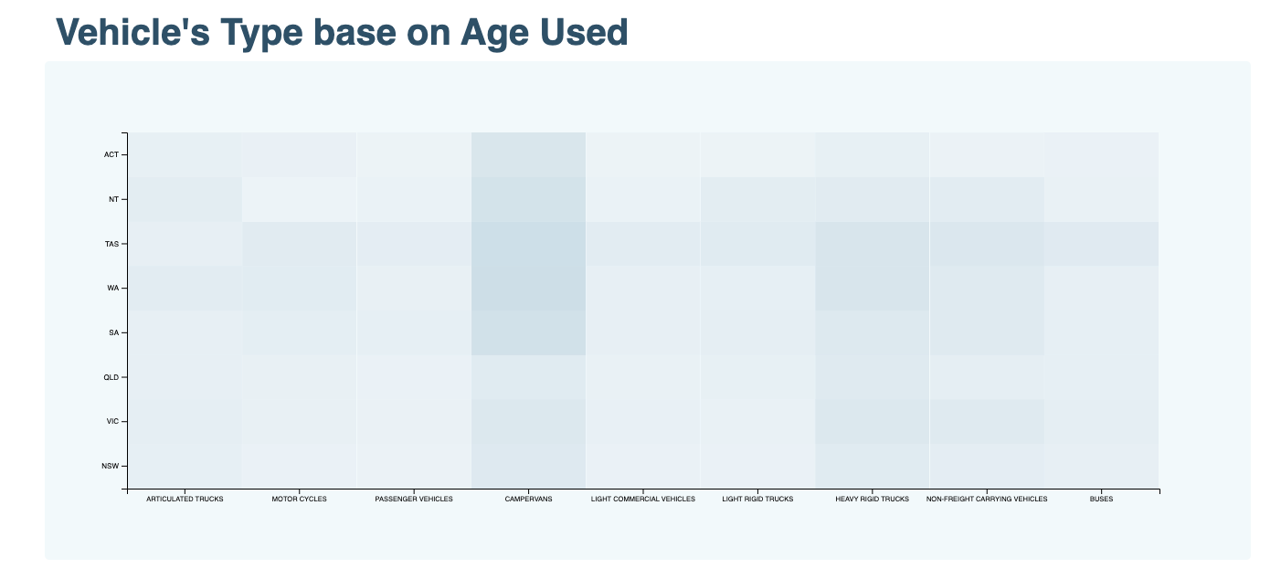
Dashboard – Heat map

Slide 11
Limitations & further investigations
P
Car registration can be transferred hence the data may not show the full picture of the increase in the new registeration holders
Data does not distinguish car owners vs. car leases or individuals vs. companies
Data has been adjusted to be an average based on population size with an exception of the total car sales per brands
Vehicle registers and the average income dataset could be skewed and biased due to inclusion of data such as a person owning a car without income (i.e, students, dependant child with parental support)
Due to covid, the supply chain has been impacted which caused the data to be skewed as secondhand car’s price rose to similar level as firsthand
Restricted timeframe to complete project 3*
A

Slide 12
Summary & Findings
T
Victoria has the most represented cross section of Australia.
Average income is increasing annually across each Australia except for Northern Territory
Tasmanian’s have the longest age used for cars
Campervan age of use is highest in Western Australia, South Australia, Tasmania
Australia’s favourite car brands in descending order: Toyota, Holden, Ford.
ACT has the highest average income and shortest years of use of car
Big Corp – invest in this market
Small Car Thief – this da place 2 be
R
V

Slide 13
Time to wake up

